Slide 1
The Nature of Language
Brought to you by: Group 1 of English Class

Slide 2
Language is Symbolic
Each word represents a particular object or idea, but it does not constitute the object or idea itself.
Example:
Black is used to represent death or evil.
Life is a roller-coaster: This is symbolic because it indicates that there will be ups and downs in life that you have to weather.

Slide 3
Language is arbitrary
There is no necessary or natural relationship between the words of a given language and the concepts that they represent.
There is no inherent or logical relation or similarity between any given feature of language and its meaning.
Example:
Chair is thing we use for sit.
Language Meaning:
English : Table
Indonesian: Meja

Slide 4
Language Rules
Phonological rules → how words sound when pronounced
Example: champagne, double and occasion
Syntactic rules → the structure of language-the way symbols can be arranged
Example: I am ready for the test.
Semantic rules → Meaning of specific words and make it possible for us to agree
Example: “bikes”are for riding & “books”are for reading
Pragmatic rules → govern how people use language in everyday interaction
Example: “shut up”

Slide 5
Connotative and Denotative
Connotative : meaning of the word includes ideas and feeling of people connect with real life.
Denotative : meaning of word is given based on dictionary.

Slide 6

Example
-Denotative : Low in cost.
-Connotative : Poorly made, made with inferior ingredients or products.

Slide 7
Language is dependent on culture
Based on culture language will be change and it’s going to change even we see the meaning of things
There’re something call sapir-whorf hypothesis.
The sapir-whorf hypothesis is made up linguistic determinism and linguistic relativity.

Slide 8
Linguistic determinism: is the notion that the worldview of a culture is shaped and reflected by the language its member speak.
Linguistic relativity: is the notion that language exert a strong influence on perception.does seem valid.
If you don’t have a word for it then it exist for you this is a very contentious point amongst many people within the realm of communication in linguistic just know that your culture defines a lot about how you see language and how you use it.

Slide 9
Example: The word shag in US it refer rug, but if I set the word shag in UK it refer to sexual act.

Slide 10
Language Clarity
Abstract
Concrete

Slide 11
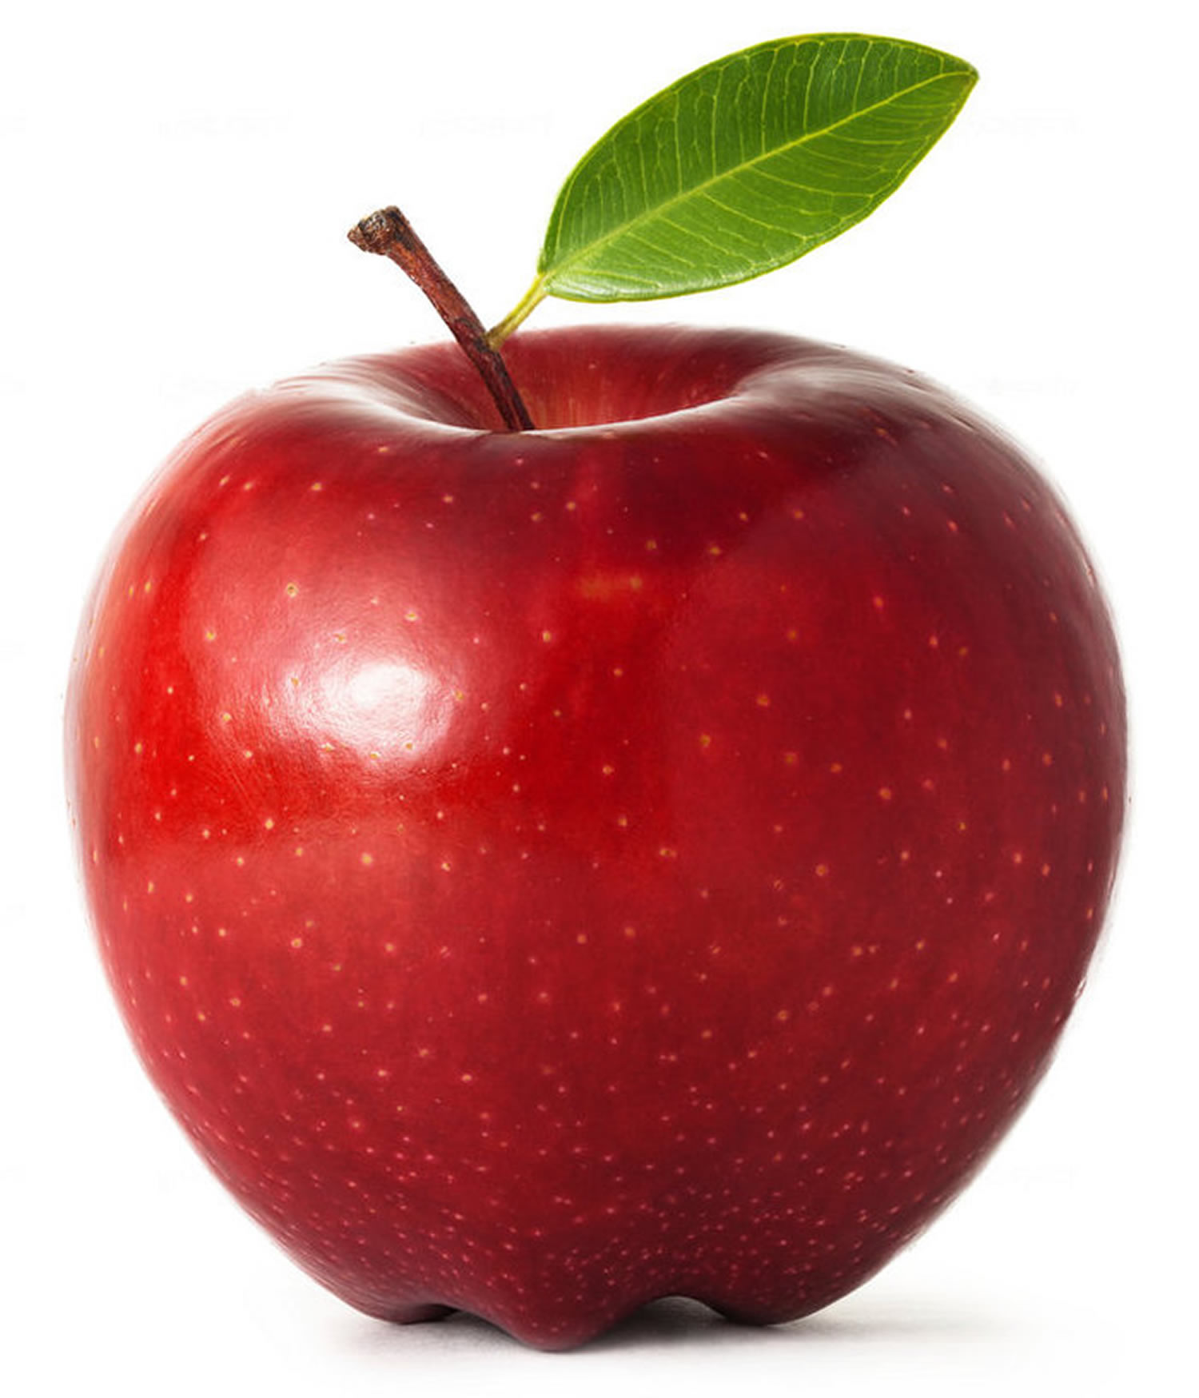

Language Clarity
Apple

Slide 12
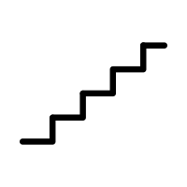
Ladder of Abstraction
An Object
An Organic Object
Food
Fruit
Apple
A bright red Apple

Slide 13
Summary
Language represents objects or ideas.
The sound and the spelling of a word has no relationship with the word’s meaning.
Every language comes with rules that govern communication.
Meanings of word are understood differently.
Language is different from culture to culture.
One word can mean a lot of things.

Slide 14
Thank you

